Slide 1
DEBT VOLATILITY GAME
RETURN
VOLATILITY
BONDS
INTEREST RATE

Slide 2
Types of Debt Instrument
Money Market ( Short Term)
Fixed Income ( Long Term)
Treasury Bill (-Tbills)
Fixed Deposits
Commercial Papers & Certificate of Deposits
Bonds/NCDs/ Debenture
Call Money
CBLO
Securitisation & Pass through Certificate

Slide 3
How RBI manages interest Rate
04
Bank Rate & OMO
03
MSF
02
Reverse Repo
01
Repo Rate

Slide 4
Borrowing Pattern
Investors | G-SEC |  |  | Corporate
 | G-Sec | SDL | T-Bills | Corporate Bonds | CP | CD
MFs | 1.50% | 2.40% | 8% | 23% | 66% | 59%
Insurance | 23% | 33% | 4.50% | 35% | 34% | 41%
Banks | 43.10% | 43.80% | 63% | 15%
FIIs | 3.53% | 0.07% | NA | 9.04%
PFs | 6.27% | 17.30% | 0.35% | 18%
Others | 7.91% | 3.37% | 24.13%
RBI | 14.70% | 0.06% | 0.02% | NA | NA | NA

Slide 5
3 Dimensional View of Fixed Income Market
Bond price is determined by
Interest rate & Duration
Macro Economic Factors
Credit Rating
Accrual Funds
Duration play
Liquid Funds

Slide 6
Credit Rating Agencies & Scale
Long Term Rating
CRISIL AAA (Highest Safety)
CRISIL AA (High Safety)
Short Term Rating
CRISIL A1 (Highest Safety)
CRISIL A (Adequate Safety)
CRISIL BBB (Moderate Safety
CRISIL B (High Risk)
CRISIL BB (Moderate Risk)
CRISIL D Default
CRISIL A2 (High Safety)
CRISIL A3 Moderate Safety)
CRISIL A4 Very High Risk)
Credit Rating Agencies
CRISIL
ICRA
CARE
SMERA
Fitch India
Brickwork Ratings
India Ratings

Slide 7
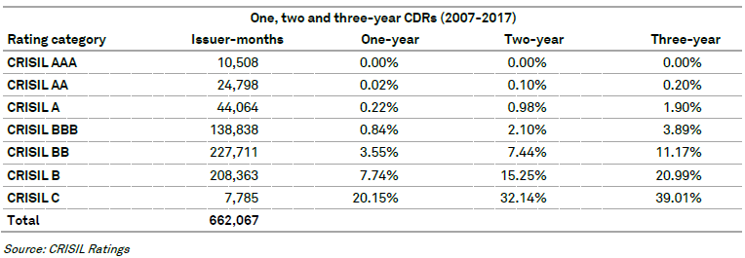
Long Term Study - CRISIL

Slide 8
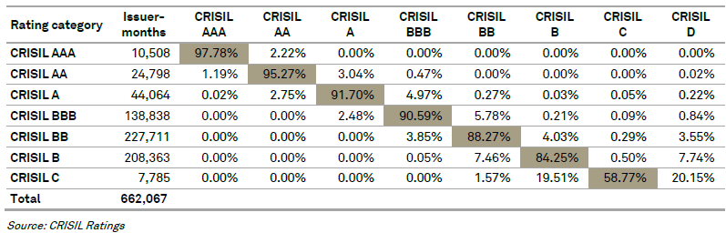
Long Term Study - CRISIL

Slide 9
Effects of Interest Rates on Bond Prices
Bond prices
Interest Rates
6.3%
Price of Bond is Inversely Proportional to Interest Rates
Bond prices
Interest Rates

Slide 10
Understanding difference between Yield, YTM & Coupon
Coupon Rate:
A bond's coupon rate is the actual amount of interest income earned on the bond each year based on its face value.
Current Yield
This is the annual return earned on the price paid for a bond. It is calculated by dividing the bond's coupon rate by its purchase price.
Yield to Maturity
This reflects the total return an investor receives by holding the bond until it matures. A bond’s yield to maturity, or YTM, reflects all of the interest payments from the time of purchase until maturity, including interest earned on interest.
When a bond is purchased at face value, the current yield is the same as the coupon rate. But let’s say the bond was purchased at a discount to face value – Rs 900. The current yield would be 6.6% (Rs 60/ Rs 900).
Let's work it out with an example: Par value (face value) = Rs 1,000 / Current market price = Rs 920 / Coupon rate = 10%, which means an annual coupon of Rs 100 / Time to maturity = 10 years.
Taking the above example and using the formula, the YTM would be calculated as follows: YTM = Rs 100 + [(Rs 1,000-Rs 920)/10] / (Rs 1,000+Rs 920)/2 after solving the above equation, the YTM would be 11.25%.

Slide 11
Yield Curve & Spread
Yield Curve: difference between yield of two bond with different credit profile
Yield Spread: Higher the risk higher the spread

Slide 12
Yield Movement
CAGR Return of 10%

Slide 13
Macaulay’s Duration & Modified Duration
Duration:
It’s the risk of a Debt portfolio
Mod Duration:
Its the sensitivity of the Bond Portfolio to the change in market yield
Duration helps determine the break even point of a debt investment
Higher the Duration, Higher the time to break even and hence more volatile would be the debt. If interest rates are suppose to fall, fund managers invest in higher duration bonds and vice versa
If the Duration of the Bond Portfolio is 5, it means the portfolio will move 5% for every 1% movement in the market yield
If market yield falls by 1%, the bond portfolio should generate 5% positive returns
If the market yield rises by 1%, the bond portfolio should generate 5% negative returns
If the yield goes down by 0.5%, the bond portfolio should generate 5% * 0.5 = 2.5% positive returns and vice-versa

Slide 14
How to Choose depending upon Market Timing
Lets assume a Debt Funds with the following data
Expecting Interest
Rates to rise by 0.25%
 | Fund X | Fund Y | Fund Z
YTM | 8% | 8.5% | 10.0
Average Maturity | 1 Years | 10 Years | 3 Years
Duration | .09 | 4.9 | 2.12
Expense Ratio | 1.40 | 1.28 | 1.70
B
A
C
Expecting Interest
Rates to fall by 0.25%
No Interest Rate
movement expected

Slide 15
Macro Economics Affecting Debt
Forming a view on the Market Movement
Parameter | Market Movement | Bond Prices
Inflation | UP | DOWN
Fiscal Deficit | UP | DOWN
Credit Rating | UP | UP
CAD, External Trade | UP | DOWN
Banking Liquidity | UP | UP
Crude | UP | DOWN

Slide 16
G-Sec & OIL

Slide 17
G-Sec & Inflation

Slide 18
USDINR & G-SEC

Slide 19
How to effectively Manage Volatility in Debt Mutual Funds
We can quickly sum up by following just 3 Rules:
When Rates have peaked –
When rates are Falling
When Interest Rates are moving Upward
It’s the best time to
Invest in Low Duration/Credit Risk
Short Term Funds or Income or Dynamic Fund as it has G-Sec Composition
.
Stick to Pure Liquid Funds

Slide 20
Mutual Fund Fact Sheet Analysis:
Funds don’t disclose if there are any investor who owns a substantial chunk of outstanding units. If there are such investors and they decide to redeem their holdings, the fund could be forced to sell holdings below the market rates.
Government securities, corporate debt , NCD, Structured obligations etc.
Asset Allocation
Avoid schemes with small corpuses
One should consider the return after excluding expense ratio: Return = Yield - Net Expenses ( In most of the sheet expenses ratio is written in the last page)
Return
A large percentage of corporate debt in the portfolio does not bode well in the short term, as it is relatively less liquid. If the fund faces redemption pressure, it would be forced to sell these securities at a discount, lowering the NAV. Also, beware of funds that hold a lot of unrated and unlisted debt.
01
02
07
02
FACT SHEET ANALYSIS
Credit Rating
Returns can potentially enhanced by lowering credit quality of the portfolio, which enhances the credit risk
Portfolio Liquid
03
06
03
06
04
05
04
05
Check the Average Maturity of the fund’s
Mod Duration
The lower the average maturity period, the lower the funds volatility and your returns and voce versa.
It Indicates the price sensitivity of the portfolio to a given change in interest rates; a measure of the fund's volatility.

Slide 21
S.NO | Fund Category | Interest Rate Risk Portfolio Macaulay duration, Maturity | Credit risk ( where the fund can invest?)
1 | Overnight Fund | Investment in securities maturing in 1 day | No restriction specified. However investment likely to be in Call money/ CBLO intruments
2 | Liquid Fund | Maturity of upto 91 days | No restriction
3 | Ultra Short Duration Fund | Macaulay duration between 3 and 6 months | No restriction
4 | Low Duration Fund | Macaulay duration between 6 and 12 months | No restriction
5 | Money Market Fund | Investment in securities maturing in upto 1 year | Money market instruments (includes treasury bills, repo, commercial paper, certificate of deposit etc)
6 | Short duration Fund | Macaulay duration between 1 year and 3 years | No restriction
7 | Medium Duration Fund | Macaulay duration between 3 years and 4 years can be reduced to upto 1 year under anticipated adverse situation | No restriction
8 | Medium to Long Duration Fund | Macaulay duration between 4 years and 7 years can be reduced to upto 1 year under anticipated adverse situation | No restriction
9 | Long Duration Fund | Macaulay duration greater than 7 years | No restriction
10 | Dynamic Bond fund | No restriction on maturity and macaulay duration. Permitted to invest across duration. | No restriction
11 | Corporate bond Fund | No restriction | At least 80% of total assets in corporate bonds rated AA+ and above
12 | Credit Risk Fund | No restriction | At least 65% of total assets in corporate bonds rated AA and below
13 | Banking and PSU Fund | No restriction | At least 80% of in debt securities of banks, PSU's, public financial institutions and municipal bonds
14 | Gilt fund | No restriction | At least 80% in government security. Government securities have zero credit risk
15 | Gilt Fund with 10 year Constant Duration | Macaulay duration of 10 years | At least 80% in government security. Government securities have zero credit risk
16 | Floater Fund | No restriction | At least 65% of total assets in floating rate instrumentsincluding swaps, derivatives etc.

Slide 22
Fixed Deposit vs FMP
Particulars | Fixed Deposit
Amount invested | 1,50,000 @8%
Maturity amount | 2,20,400
Tax at 30.9% | 21,750
Post tax returns | 1,98,650
Particulars | FMP
Maturity Value | 2,25,550
Less: Indexed Cost of Acquisition = (150000*1125)/785 | 2,14,968
Long term Capital gains | 10,581
Long term capital gains tax (20.6%) | 2180
Particulars | Amount | Date
Amount invested | 1,50,000 | 1/04/2013
After tax sales price | 1,98,650 | 1/4/2018
Post tax gains (%) | 5.78
Particulars | Amount | Date
Amount invested | 1,50,000 | 1/10/2013
After tax sales price (2,25,500-2180) | 2,23,369 | 1/10/2019
Post tax gains (%) | 8.2%

Slide 23
SWP through Debt Funds is better alternative than Balanced Fund
Scheme | Tenure 5 years | Return (%)
Credit Risk Fund | 03-10-2013 to 03-10-2018 | 8.5
Scheme | Withdrawal Period | Return (%)
Low Duration Fund | 03-10-2013 to 03-10-2018 | 8%

Slide 24
Thank You

